Slide 1
RAID Configuration
-Janki Trivedi(121018)

Slide 2
Introduction
RAID : Redundant Array of Independent Disks
RAID scheme consists of seven levels : zero to six
in computer storage, standard RAID levels comprise a basic set of RAID configuration that employs the basic technique of striping , mirroring or parity to create large reliable data stores.
Common types: RAID 0, RAID 1,RAID 5,RAID 10

Slide 3
Common Characteristics
RAID is a set of physical disk drives viewed by the OS as a single logical drive.
Data are distributed across the physical drives of an array in a scheme known as striping, described subsequently.
Redundant disk capacity is used to store parity information, which guarantees data recoverability in case of a disk failure.

Slide 4
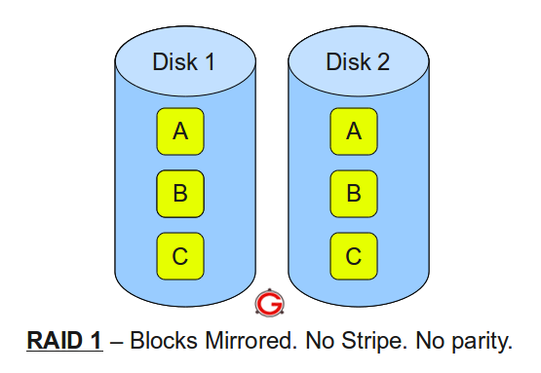
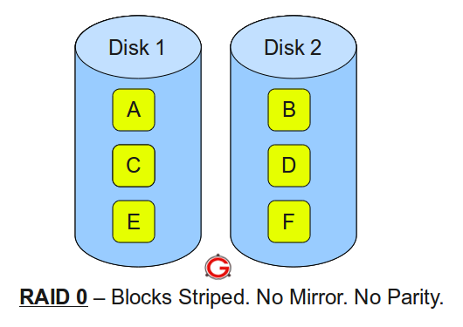
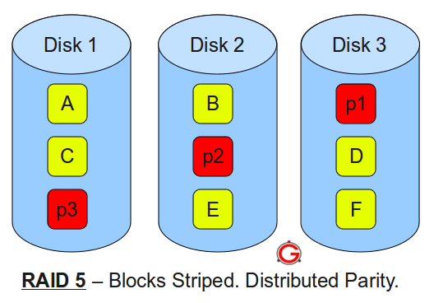
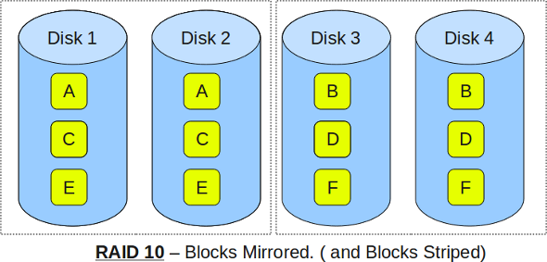
RAID levels
A, B, C, D, E and F – represents blocks
p1, p2, and p3 – represents parity

Slide 5
Software RAID vs Hardware RAID
Software RAID
the RAID implementation is an application running on the host without any additional hardware.
This type of software RAID uses hard disk drives which are attached to the computer system .
The RAID becomes active as soon as the operating system has loaded the RAID driver software.
Low cost is the primary advantage of this solution.
Hardware RAID
A hardware RAID solution has its own processor and memory to run the RAID application.
In this implementation, the RAID system is an independent small computer system dedicated to the RAID application, offloading this task from the host system

Slide 6
Fake RAID
Fake RAID is essentially software RAID provided by the BIOS on the motherboard, however, it has none of the benefits of Software RAID and none of the benefits of Hardware RAID.
Unlike Hardware RAID, Fake RAID does not present the array as a single logical disk to the OS, so the OS still needs to explicitly support Fake RAID.
Unlike Software RAID, Fake RAID does not use a consistent on disk format, and if your motherboard dies, your data is probably lost unless you can find another identical motherboard.
with Fake RAID:
Use RAID 0 or 1.
Can't nest RAID arrays.
Create RAID arrays using whole disks only.(not a partition, file, or generic block device)

Slide 7
References
http://skrypuch.com/raid/
https://www.adaptec.com/nr/rdonlyres/14b2fd84-f7a0-4ac5-a07a-214123ea3dd6/0/4423_sw_hwraid_10.pdf
http://en.wikipedia.org/wiki/RAID
http://www.thegeekstuff.com/2010/08/raid-levels-tutorial/
http://www.prepressure.com/library/technology/raid

Slide 8


